Slide 1
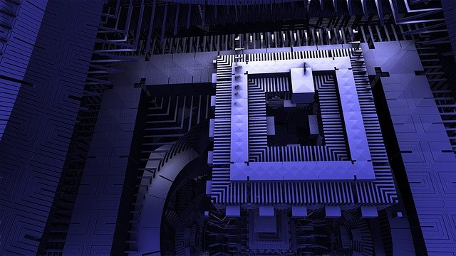
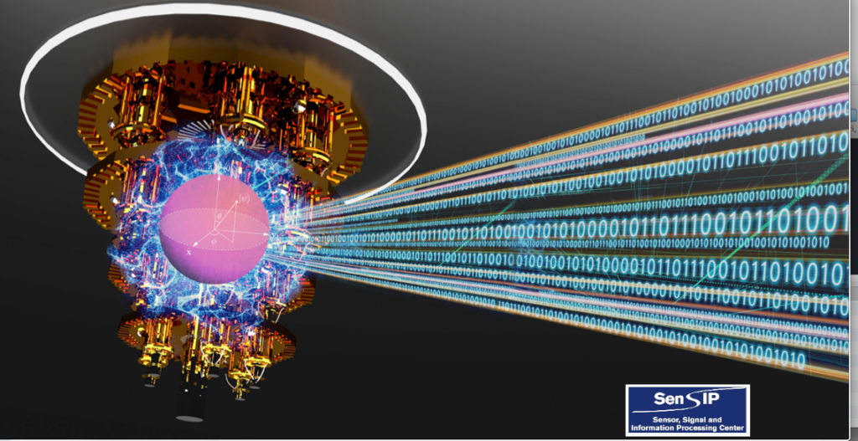
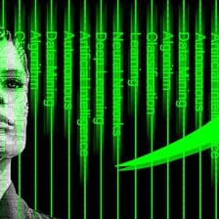
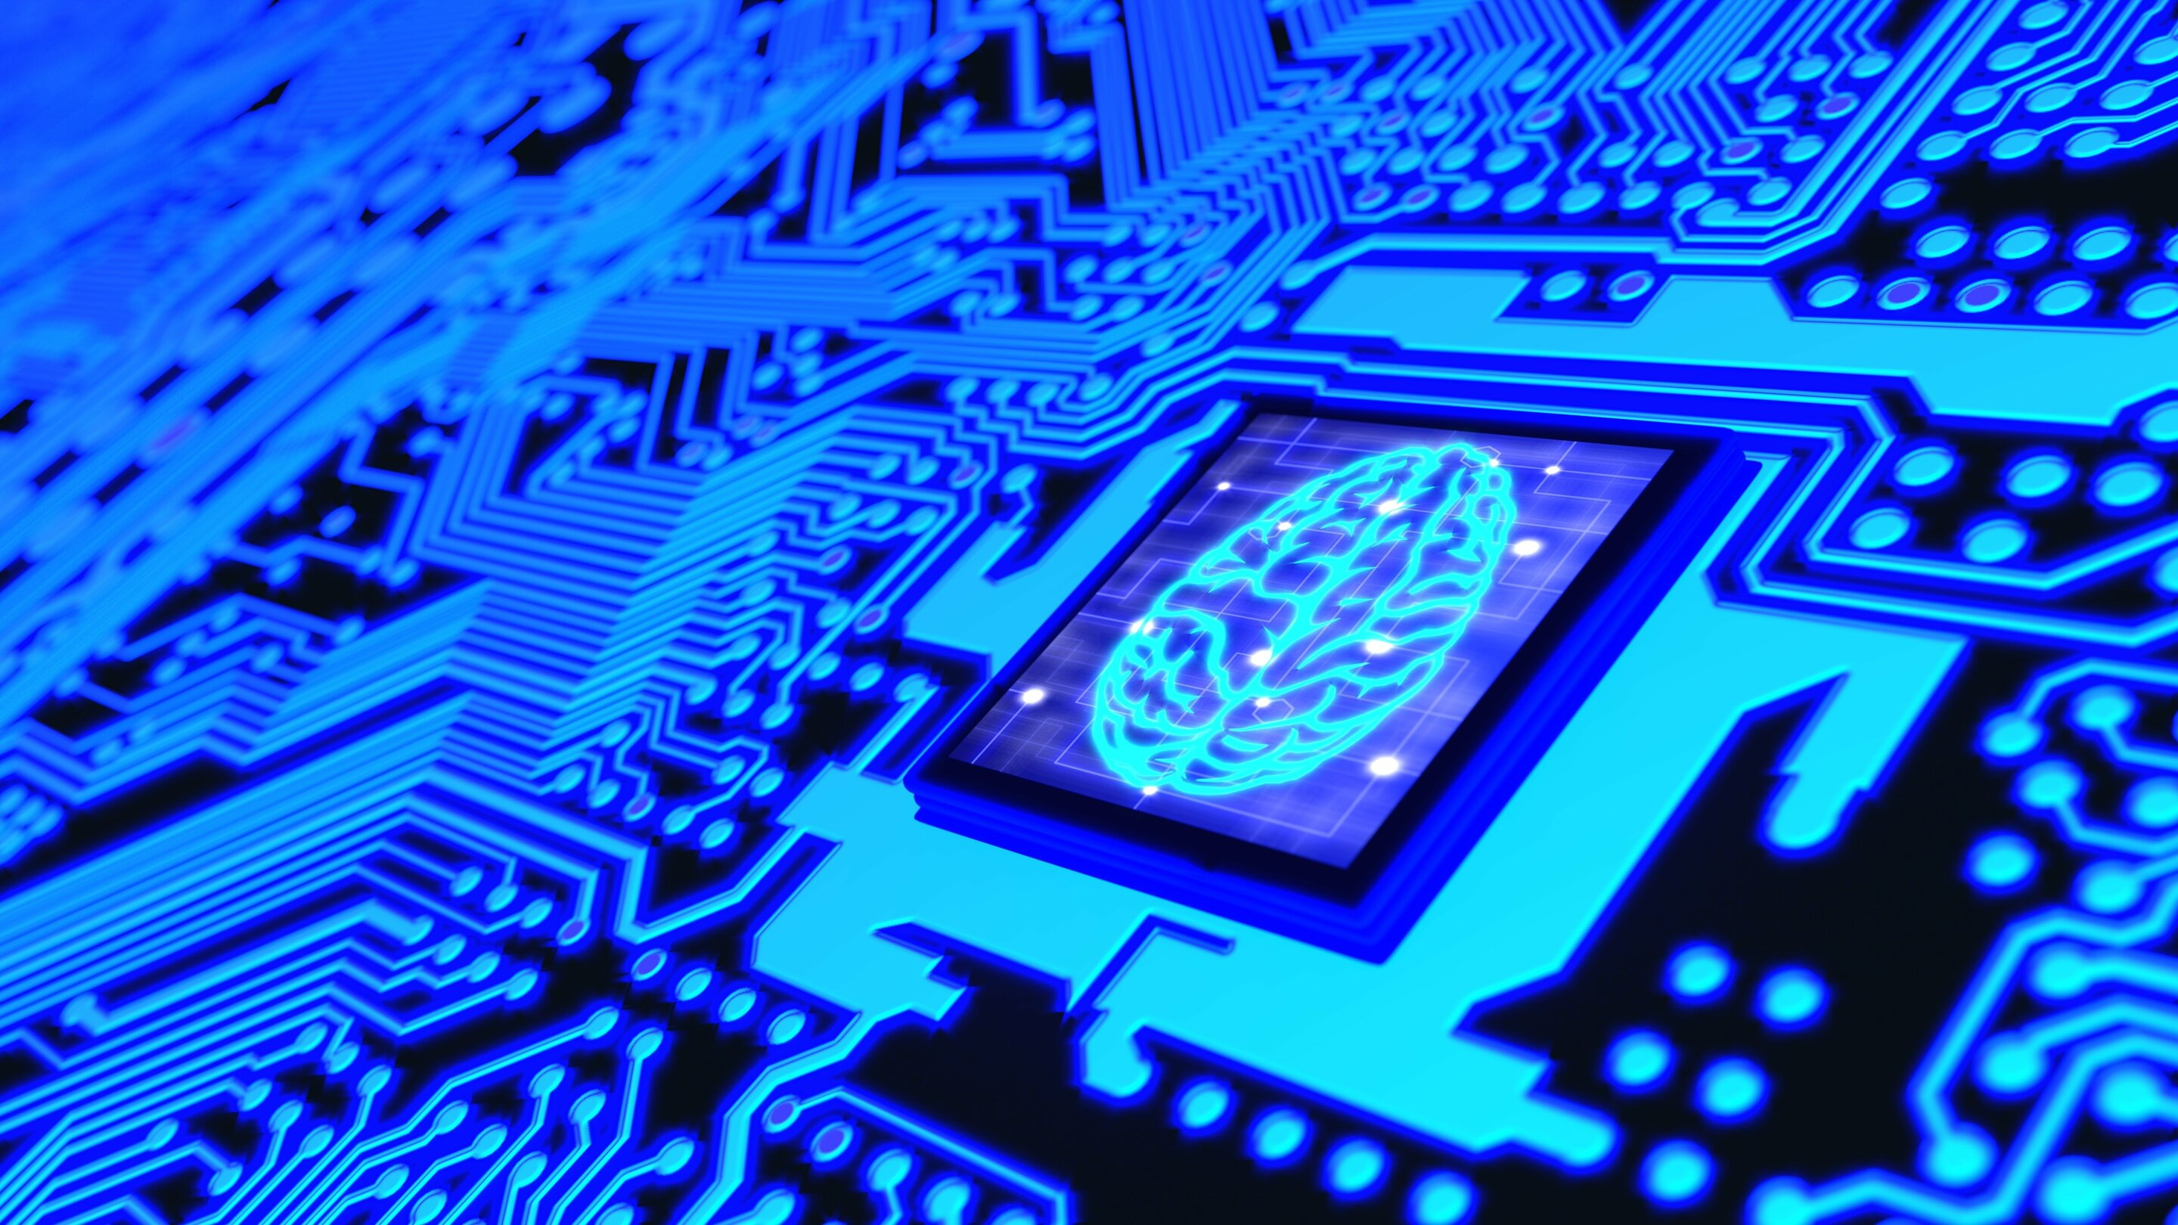
Quantum Computing Algorithms
for Machine Learning and Signal Processing

Slide 2
Agenda
Introduction to Quantum Computing Algorithms
Quantum Algorithms for Machine Learning
Quantum Algorithms for Signal Processing
Current Research

Slide 3
Quantum Terminology
Quantum Mechanics
Richard Feynman, David Deutsch in early 1980s:
Harness quantum effects for useful computations!
Quantum mechanics describe properties of nature at the scale of atoms and subatomic particles.
We can study the impact of quantum mechanics on computing using superposition, quantum measurement, and entanglement.
Quantum Information Theory
Quantum bits (qubits) two exclusive states.
These are defined as state 0 and state 1.
The laws of quantum mechanics treat these differently;
instead of looking at a discrete value, we describe these states in terms of probability
We begin with some introductory terminologies in the following pages

Slide 4
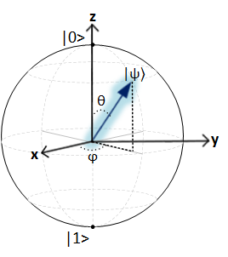
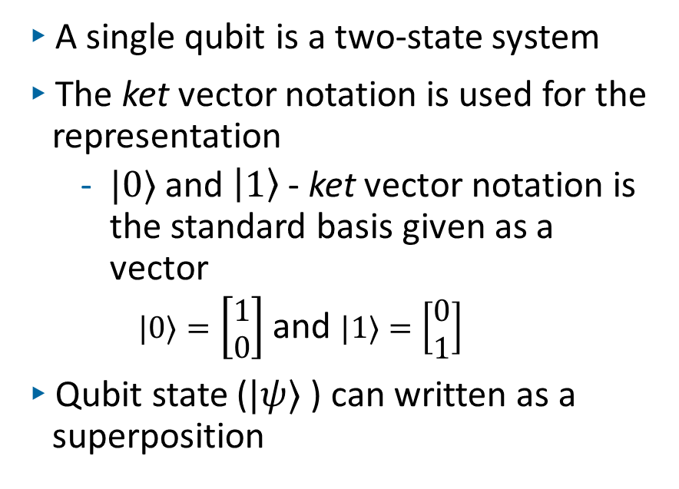
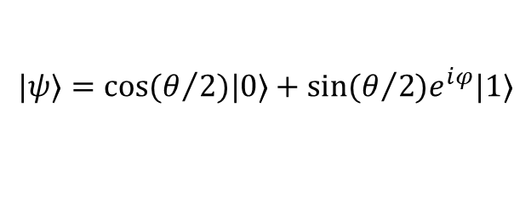
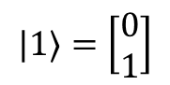
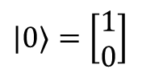
Quantum bits
A single qubit is a two-state system
The ket vector notation is used for the representation
$|0〉$ and $|1〉$ - ket vector notation is the standard basis given as a vector
$|0〉=\left[\begin{matrix}1 \\ 0\end{matrix}\right]$ and $|1〉=\left[\begin{matrix}0 \\ 1\end{matrix}\right]$
Qubit state ($|ψ〉$) can written as a superposition
$|0〉=\left[\begin{matrix}1 \\ 0\end{matrix}\right]$
$$|1〉=\left[\begin{matrix}0 \\ 1\end{matrix}\right]$$
$$|ψ〉=cos(θ/2)|0〉+sin(θ/2)e^{ⅈφ}|1〉$$

Slide 5
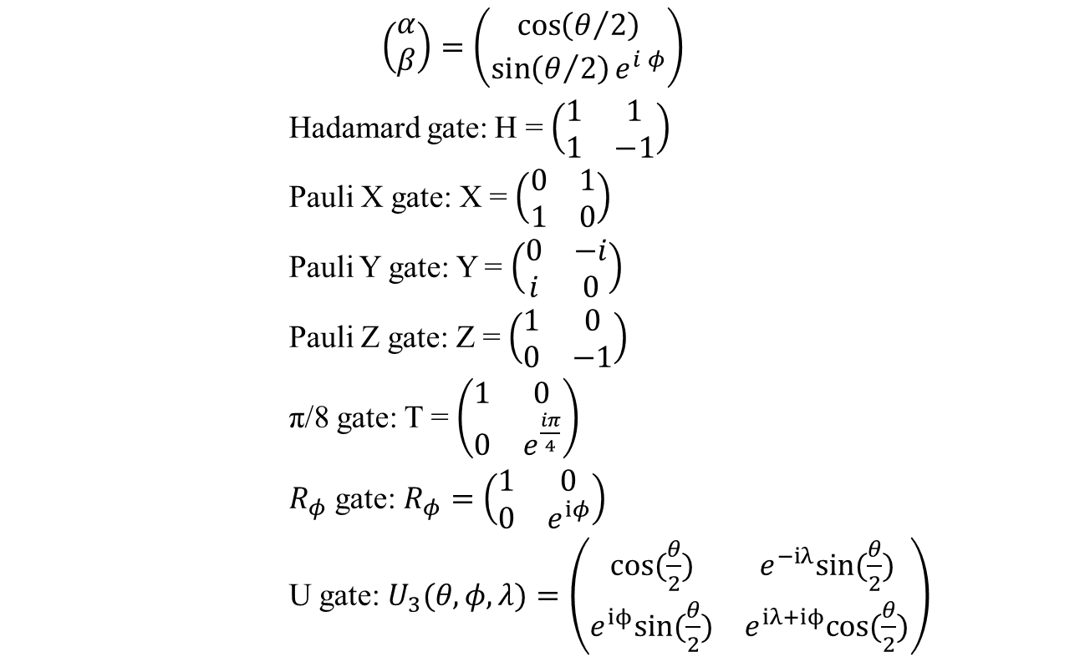
Quantum Gates
$$\left(\begin{aligned}α \\ β\end{aligned}\right)=\left(\begin{aligned}\cos\left(θ/2\right) \\ \sin\left(θ/2\right)e^{ⅈ φ}\end{aligned}\right)$$
Hadamard gate: H = $\left(\begin{matrix}1 & 1 \\ 1 & −1\end{matrix}\right)$
Pauli X gate: X = $\left(\begin{matrix}0 & 1 \\ 1 & 0\end{matrix}\right)$
Pauli Y gate: Y = $\left(\begin{matrix}0 & −i \\ i & 0\end{matrix}\right)$
Pauli Z gate: Z = $\left(\begin{matrix}1 & 0 \\ 0 & −1\end{matrix}\right)$
π/8 gate: T = $\left(\begin{matrix}1 & 0 \\ 0 & e^{\frac{iπ}{4}}\end{matrix}\right)$
$R_{φ}$ gate: $R_{φ}=\left(\begin{matrix}1 & 0 \\ 0 & e^{iφ}\end{matrix}\right)$
U gate: $U_{3}(θ,φ,λ)=\left(\begin{matrix}cos(\frac{θ}{2}) & e^{−iλ}sin(\frac{θ}{2}) \\ e^{iϕ}sin(\frac{θ}{2}) & e^{iλ+iϕ}cos(\frac{θ}{2})\end{matrix}\right)$
Quantum gates are represented as unitary matrices: U^{H}U=I
Quantum gates are used to build quantum circuits
The Pauli gates are examples of quantum gates
H
X
Y
Z
T
R_{x}
R_{y}
R_{z}

Slide 6
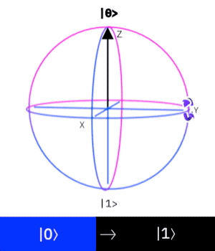
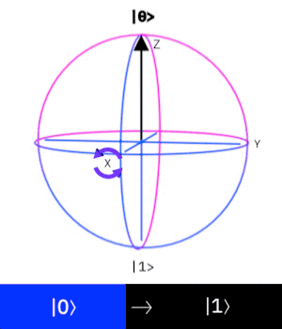
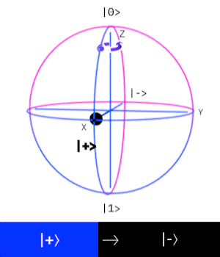
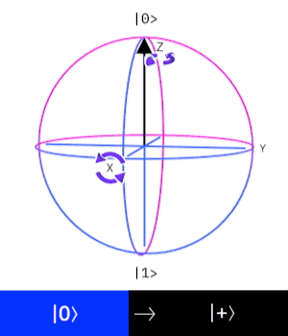
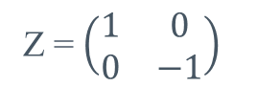
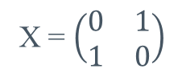
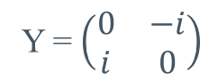
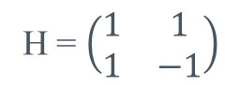
Qubits and Quantum Gates
We see here how to apply the quantum gates to a qubit
https://lewisla.gitbook.io/learning-quantum/quantum-circuits/single-qubit-gates
Y
X
Z
H
Y = $\left(\begin{matrix}0 & −i \\ i & 0\end{matrix}\right)$
X = $\left(\begin{matrix}0 & 1 \\ 1 & 0\end{matrix}\right)$
Z = $\left(\begin{matrix}1 & 0 \\ 0 & −1\end{matrix}\right)$
H = $\left(\begin{matrix}1 & 1 \\ 1 & −1\end{matrix}\right)$

Slide 7
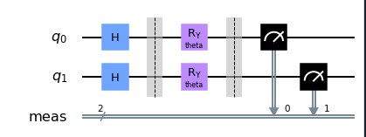
Quantum Circuit
We can put together the quantum gates with qubits (q₀, q₁) to build a circuit
A quantum circuit consists of wires and logic gates
We build quantum circuits with quantum gates to transform these qubits
We take measurement of the qubits to determine the new state

Slide 8
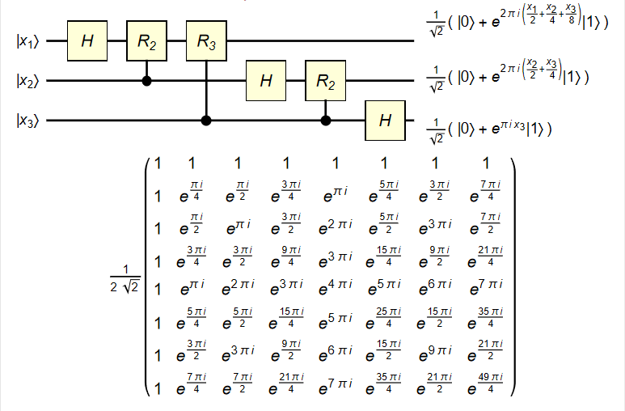
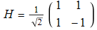
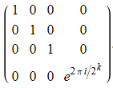
Quantum Fourier Transform
To quickly demonstrate the qubits, quantum gates and quantum circuits, we show an example using QFT
We represent this 2^{n}x2^{n} unitary matrix, where n is the number of qubits
=
https://demonstrations.wolfram.com/QuantumFourierTransformCircuit/

Slide 9
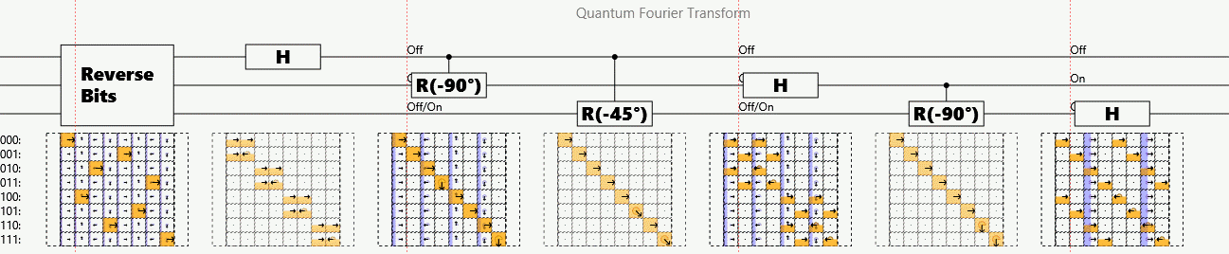
QFT Animation of three-qubits
https://algassert.com/quantum/2014/03/07/Building-your-own-Quantum-Fourier-Transform.html
We can show the transform occurring here for a 3 qubit QFT

Slide 10
Quantum Information Processing
With the superposition states of photons and atoms, Quantum Information Processing (QIP) can process, store, and transmit data in ways that exceed classical systems
We present the term Quantum Algorithms as the algorithm to implement our design for QIP systems
We then try to realize the benefits of using Quantum Systems.

Slide 11
Quantum Algorithms
Quantum Algorithms are procedure to perform calculation to solve a problem
The strength of quantum algorithm is when we use the quantum superposition or entanglement
The quantum enhancements of the algorithms helps build new quantum inspired algorithms.
We can use these algorithms to solve problems such as some NP-Complete
We also realize algorithms such as Grover and Shor’s algorithms
As we shown earlier, we can also use quantum algorithms to perform QFT, which are similar to Discrete Fourier Transforms (DFT)

Slide 12
Quantum Algorithms and Quantum Machine Learning
Quantum algorithms are used for information processing
When we apply these to specific areas, we can emphasize some of the algorithms for information processing to Quantum Machine Learning (QML)

Slide 13
QML Algorithms and Systems
With the intersection of Quantum Information Processing and Machine Learning, we can begin building quantum inspired algorithms
Classical Algorithms | Quantum Algorithms | Description
Support Vector Machine Algorithms (SVM) | Quantum-Support Vector Machine Algorithms (QSVM) | Quantum computing will enable the use of kernels which are hard to compute classically
Eigensolver | Variational Quantum Eigensolver (VQE) (hybrid quantum-classical) | The computational advantage when the classical resources (memory; number of operations), required to solve a particular problem is limited
Neural Network (NN) | Quantum Neural Network (QNN) | Advantages of quantum information processing to develop more efficient algorithms (training for big data, for example)

Slide 14
How we built our Quantum System
We begin using Qiskit from IBM as our Software Development Kit (SDK)
This provides the foundation to build a quantum circuit that will run on a quantum simulator and IBMQ quantum hardware
Using the tutorial provided by Qiskit, we can quickly develop simple QML system
As we dive in more into the learning aspects, we begin changing our quantum circuit and our algorithms to see where we can improve our algorithsm.
Currently, we utilize both classical and quantum system to build a hybrid quantum-classical system
For this, we will go through a simple Quantum Neural Network design

Slide 15
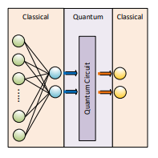
Hybrid Quantum Neural Network Example
We begin with a classical network
Here we build the quantum circuit as a hidden layer
We use the classical system as input and output to help prepare and present the data

Slide 16
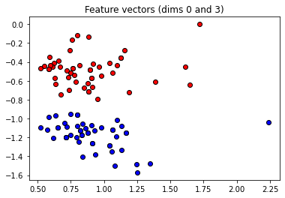
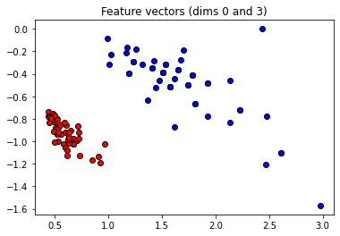
Simple dataset
To demonstrate the quantum circuit, we use a simplified Iris dataset to categorize only two
Here we prepare the dataset to feed into the quantum circuit
1. State Preparation using Iris data set looking at only two classifier data (setosa, versicolor).

Slide 17
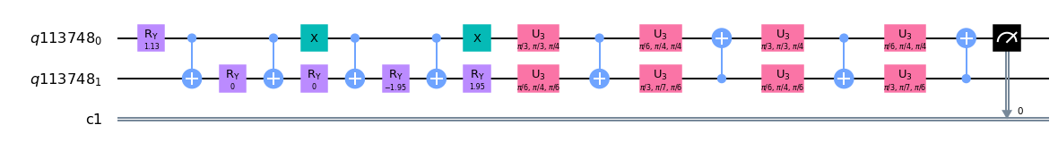
Build a quantum circuit
We next build our quantum circuit
Here we take two qubits and take only one measurement
2. Quantum model circuit: Two qubit quantum circuit for machine learning algorithms

Slide 18
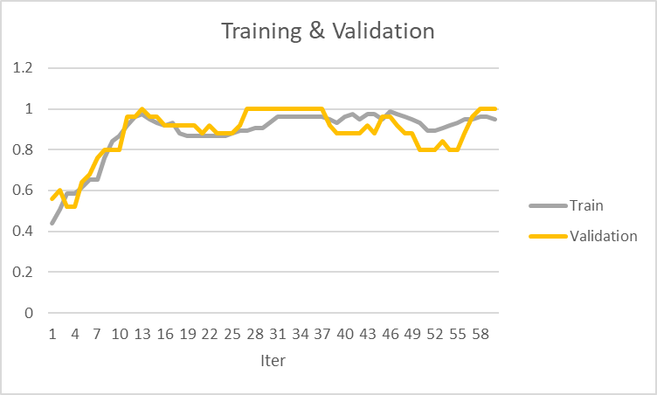
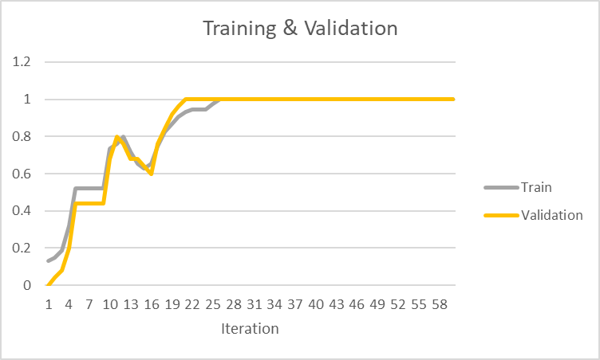
Training and Validation
As we run and train our model, we present the results
We can see, using the circuit shows different results based on how the dataset are prepared
3 & 4. Measurement, Post-Process result of the simulation

Slide 19
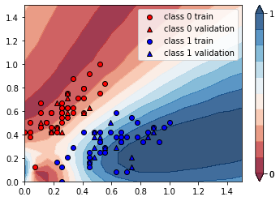
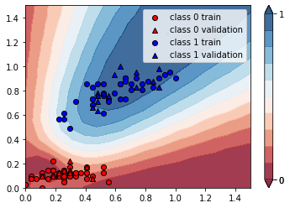
Our results

Slide 20
Building ML based algorithms
Today, we begin by building hybrid quantum-classical systems
This takes advantages of classical solutions and accelerates some of the computation in quantum machines
Hybrid algorithms are already running a solving problems today with Quantum-Inspired Algorithms
Quantum-inspired optimization
Quantum-inspired estimation (coefficient estimation)
Research is now looking at building hybrid quantum-classical machine learning systems
Building a system that takes advantages of quantum mechanics
Looking to find solutions to problems that cannot be realized on classical computing systems
[1] Arrazola JM, Delgado A, Bardhan BR, Lloyd S. Quantum-inspired algorithms in practice. arXiv preprint arXiv:1905.10415. 2019 May 24.

Slide 21
Quantum Machine Learning
We have begun our research in QML
Starting with a survey of applying quantum algorithms
Build hybrid system that could process data
IRIS dataset
MNIST dataset
WINE dataset
We are using these models to train and test against other types of data
NREL data for fault detection
[2] Dobos A. PVWatts version 1 technical reference. Nrel/Tp [Internet]. 2013;(October):1 online resource (8 pages). Available from: http://purl.fdlp.gov/GPO/gpo51913
[3] Uehara G, Rao S, Dobson M, Tepedelenlioglu C, Spanias A. Quantum Neural Network Parameter Estimation for PV Fault Detection. IISA 2021, Crete, July 2021.
[4] Uehara G, Spanias A, Clark W. Quantum Computing Algorithms for Machine Learning and Signal Processing. Crete: IISA 2021, Crete, July 2021; 2021.

Slide 22
Quantum Signal Processing
In this survey, we aim our understanding of quantum signal processing (QSP) as developing new quantum inspired algorithms that applies principles of quantum mechanics to the system
We start by looking at different ways to measure a signal, this concept is described in [5] as QSP Measurement
As we know, quantum measurement is probabilistic, so research is needed to understand how to make an output from QSP measurement more deterministic
Other areas to that we are currently investigating for QSP are
Quantum detection
Denoising of system
[5] Y. C. Eldar and A. V. Oppenheim, "Quantum signal processing," in IEEE Signal Processing Magazine, vol. 19, no. 6, pp. 12-32, Nov. 2002, doi: 10.1109/MSP.2002.1043298.

Slide 23
Quantum Image Processing
Similar to signal processing, quantum image processing is another area where quantum inspired algorithms benefit current systems
Research on [6], looks at digital image processing
We also find quantum inspired algorithms that looks at
Edge Detection
Image Segmentation
[6] Yuan, S., Mao, X., Chen, L. and Xue, Y., 2013. Quantum digital image processing algorithms based on quantum measurement. Optik, 124(23), pp.6386-6390.
[7] A. Ranjan, A. K. S. Arya and M. Ravinder, "Quantum Techniques for Image Processing," 2020 2nd International Conference on Advances in Computing, Communication Control and Networking (ICACCCN), 2020, pp. 1035-1039, doi: 10.1109/ICACCCN51052.2020.9362910.

Slide 24
Our Next Steps
Working on toolbox and toolkits for Quantum Machine Learning
Develop systems to help algorithm (machine learning) engineers to quickly realize quantum systems
Hybrid quantum-classical (CPU)
Hybrid quantum-classical (GPU/CPU)
Focus these toolbox allows developers to build quantum systems without quantum mechanics (physics) background
Staying in the Mathematical and Higher-level quantum knowledge

Slide 25
Reference
[1] Arrazola JM, Delgado A, Bardhan BR, Lloyd S. Quantum-inspired algorithms in practice. arXiv preprint arXiv:1905.10415. 2019 May 24.
[2] Dobos A. PVWatts version 1 technical reference. Nrel/Tp [Internet]. 2013;(October):1 online resource (8 pages). Available from: http://purl.fdlp.gov/GPO/gpo51913
[3] Uehara G, Rao S, Dobson M, Tepedelenlioglu C, Spanias A. Quantum Neural Network Parameter Estimation for PV Fault Detection. IISA 2021, Crete, July 2021.
[4] Uehara G, Spanias A, Clark W. Quantum Computing Algorithms for Machine Learning and Signal Processing. Crete: IISA 2021, Crete, July 2021; 2021.
[5] Y. C. Eldar and A. V. Oppenheim, "Quantum signal processing," in IEEE Signal Processing Magazine, vol. 19, no. 6, pp. 12-32, Nov. 2002, doi: 10.1109/MSP.2002.1043298.
[6] Yuan, S., Mao, X., Chen, L. and Xue, Y., 2013. Quantum digital image processing algorithms based on quantum measurement. Optik, 124(23), pp.6386-6390.
[7] A. Ranjan, A. K. S. Arya and M. Ravinder, "Quantum Techniques for Image Processing," 2020 2nd International Conference on Advances in Computing, Communication Control and Networking (ICACCCN), 2020, pp. 1035-1039, doi: 10.1109/ICACCCN51052.2020.9362910.

Slide 26
Thank you

